Slide 1
Artificial Neural Network
Dr. Sourasekhar Banerjee (Ph.D)

Slide 2
Learning Outcome
By the end of this presentation, you will be able to:
  Basics of Artificial Neural Networks
  Understand the Multi-layer Perceptron
  Discussion on Complex ANN models (RNN, LSTM, CNN)

Slide 3
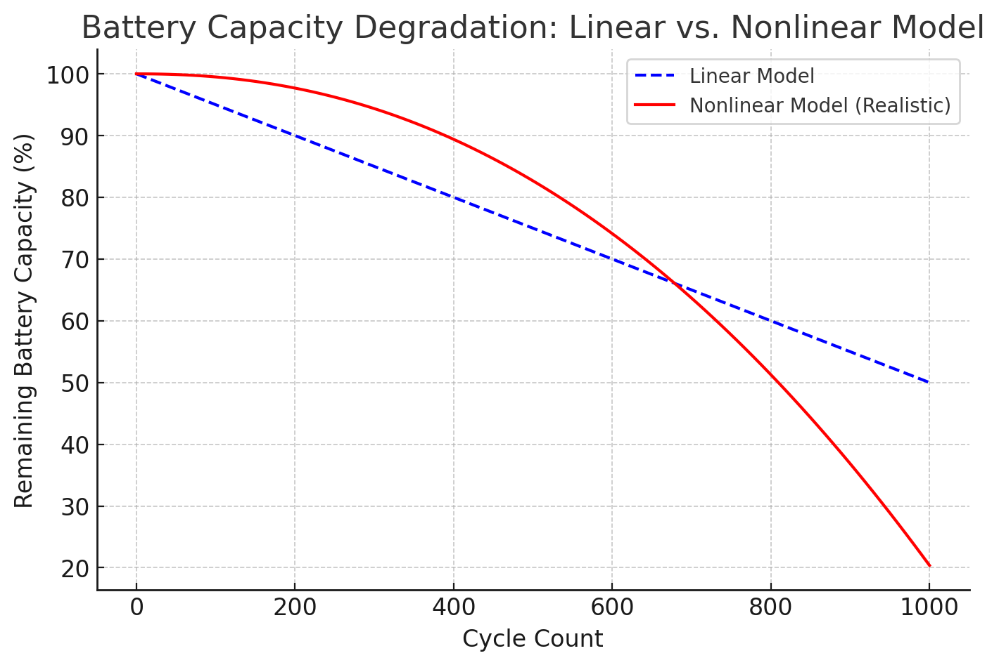
Introduction and Motivations
Nonlinear modelling capability

Slide 4
How ANNs Speed Up R&D?
Accelerated Material Discovery
  ANNs can predict the electrochemical properties of new materials without requiring full-scale synthesis and testing.
  Example: New cathode materials for Li-ion batteries can be screened via ANNs before lab experiments
Fast Performance Prediction
  ANNs analyze historical data and provide instant predictions about battery lifetime, efficiency, and degradation.
  Example: Instead of running a 6-month battery cycling test, an ANN can predict the failure point in seconds
Real-Time Optimization
  ANNs can adjust battery charging strategies dynamically to improve longevity.
  Example: In electric vehicles (EVs), an ANN-based Battery Management System (BMS) can optimize fast charging protocols without extensive real-world testing.

Slide 5
What is an ANN ?
A computational model inspired by the structure and function of the human brain, consisting of interconnected “neurons” (nodes) organized in layers.
Key Characteristics:
  Layers: Input layer, one or more hidden layers, and an output layer.
  Weights & Biases: Each connection has parameters adjusted during training.
  Activation Functions: Nonlinear transformations (e.g., ReLU, Sigmoid) allow the network to learn complex patterns.
  Learning: Backpropagation algorithm uses loss gradients to update weights, iteratively improving performance.

Slide 6


Slide 7
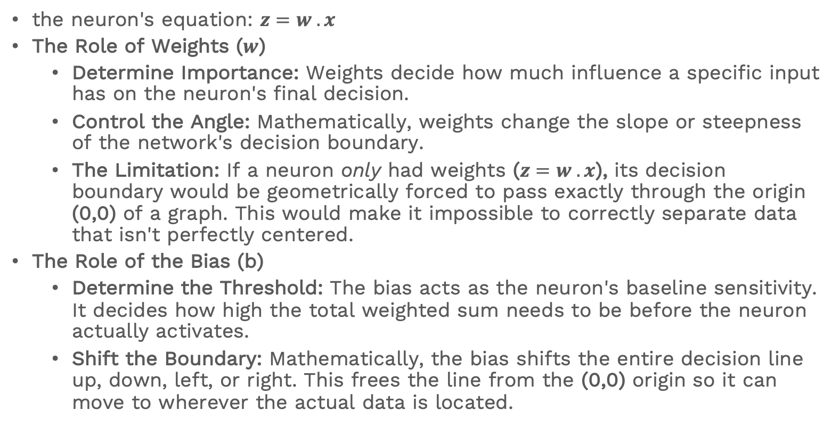
Answer
the neuron's equation: $z=w . x$
The Role of Weights ($w$)
  Determine Importance: Weights decide how much influence a specific input has on the neuron's final decision.
  Control the Angle: Mathematically, weights change the slope or steepness of the network's decision boundary.
  The Limitation: If a neuron only had weights ($z=w . x$), its decision boundary would be geometrically forced to pass exactly through the origin (0,0) of a graph. This would make it impossible to correctly separate data that isn't perfectly centered.
The Role of the Bias (b)
  Determine the Threshold: The bias acts as the neuron's baseline sensitivity. It decides how high the total weighted sum needs to be before the neuron actually activates.
  Shift the Boundary: Mathematically, the bias shifts the entire decision line up, down, left, or right. This frees the line from the (0,0) origin so it can move to wherever the actual data is located.
Notes:
The "Going to a Party" Analogy
Inputs ($x$): The raw facts of the situation (e.g., Is it raining? Are your friends going?).
Weights ($w$): How much you personally care about each fact (e.g., You hate rain, so rain gets a large negative weight).
Bias ($b$): Your baseline personality (e.g., An extrovert has a high positive bias and naturally wants to go out anyway; an introvert has a negative bias and needs a lot of strong positive input to be convinced to leave the house).

Slide 8
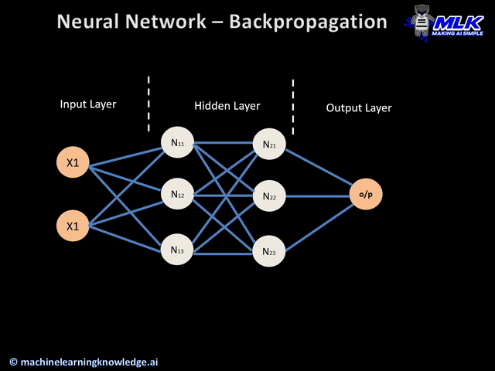
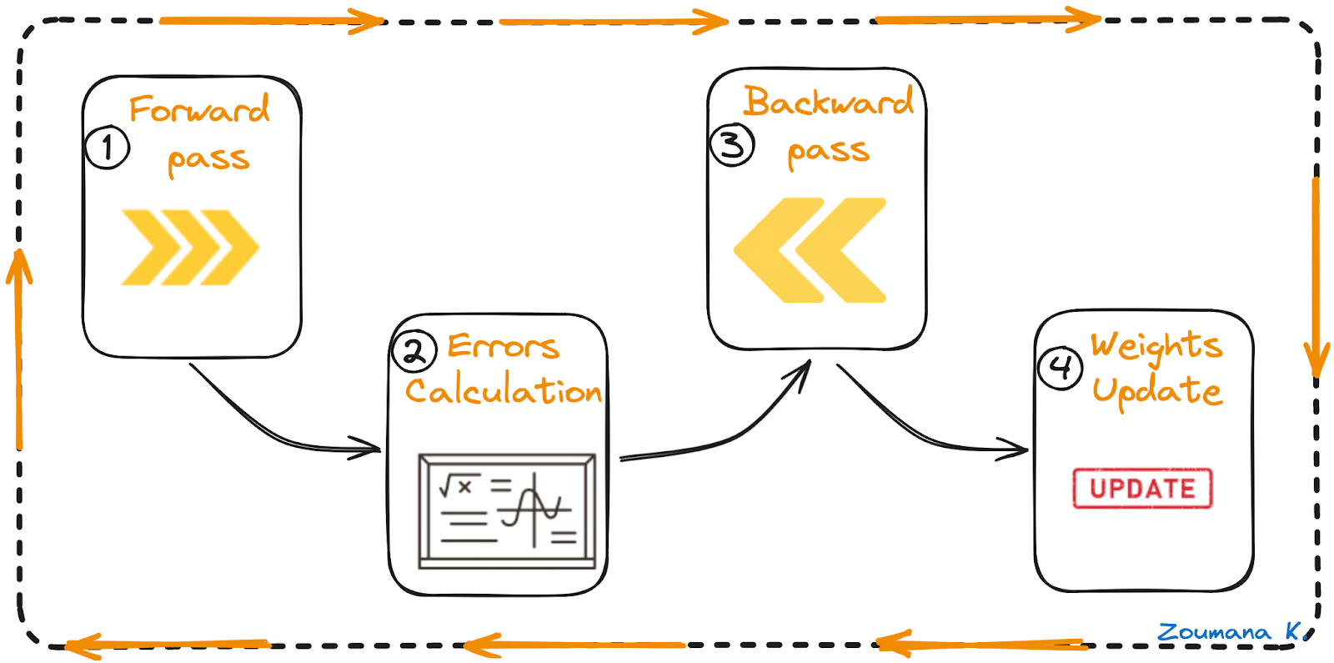
How it Works ?
Demo
Click here
https://ml4a.github.io/ml4a/looking_inside_neural_nets/

Slide 9
Forward Pass
Compute weighted sum at each neuron
Apply activation function in hidden layers
  That ensures the neural network can learn non-linear patterns
Pass the output to the next layer
Final output is generated

Slide 10
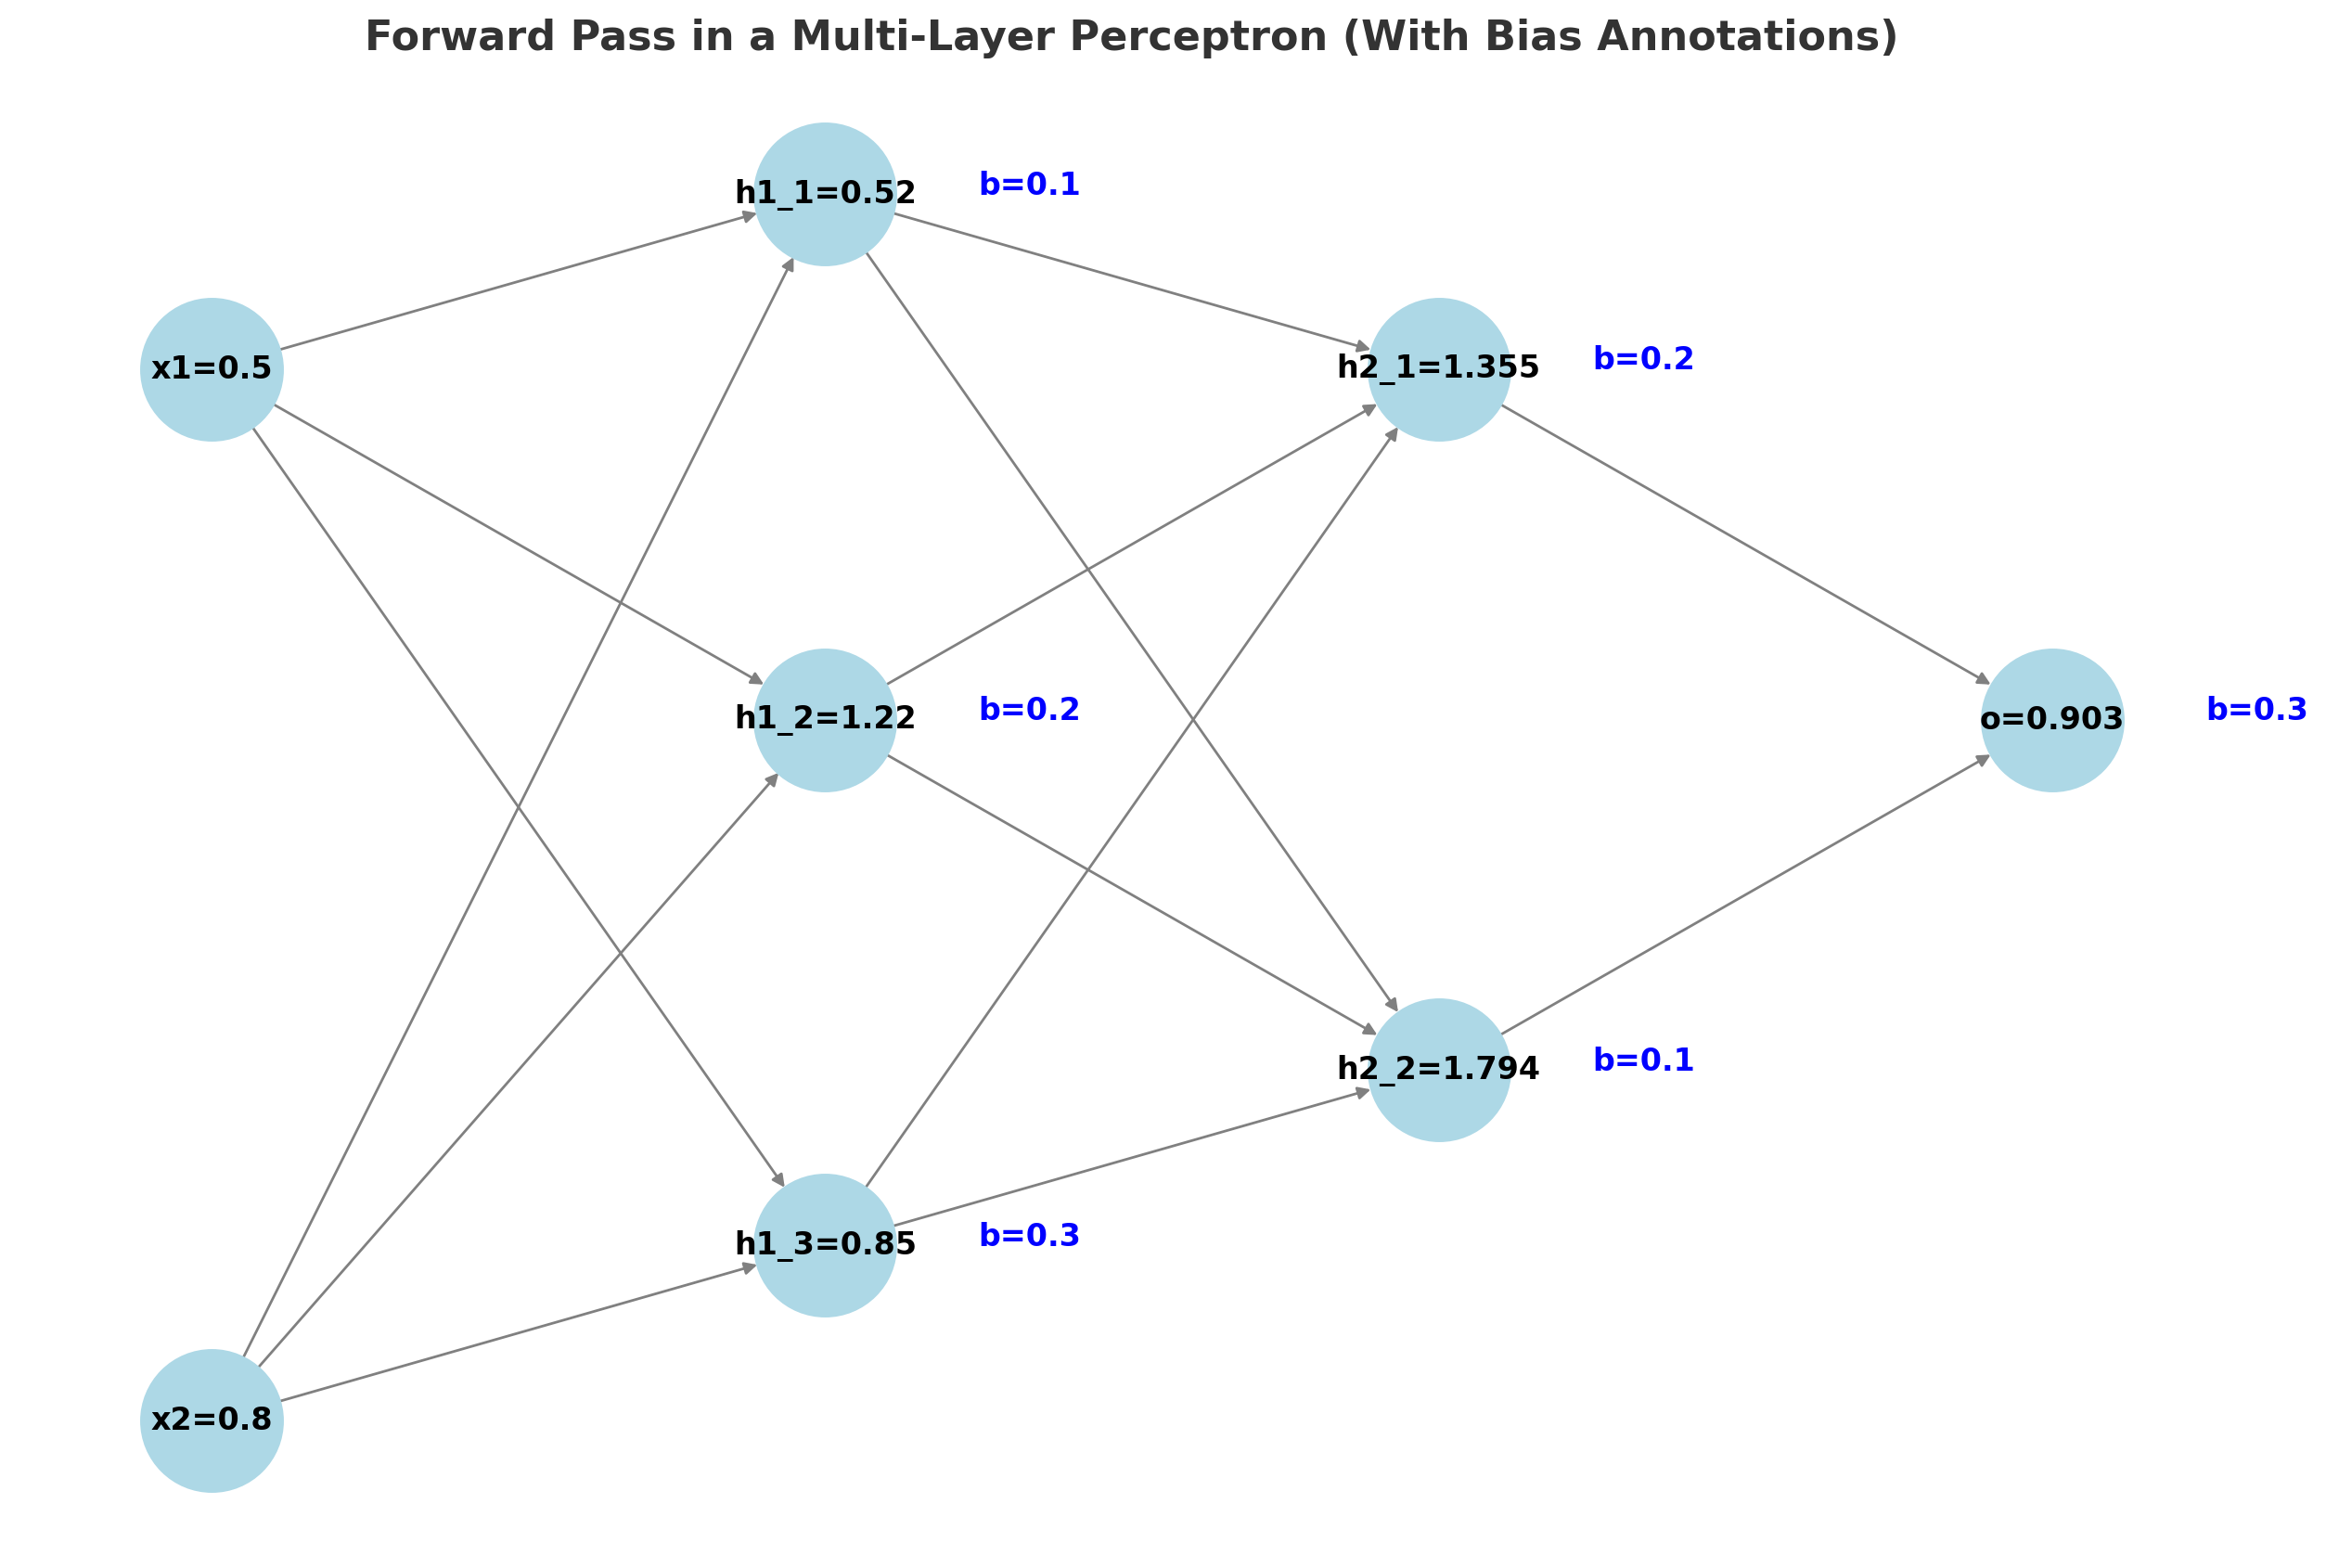
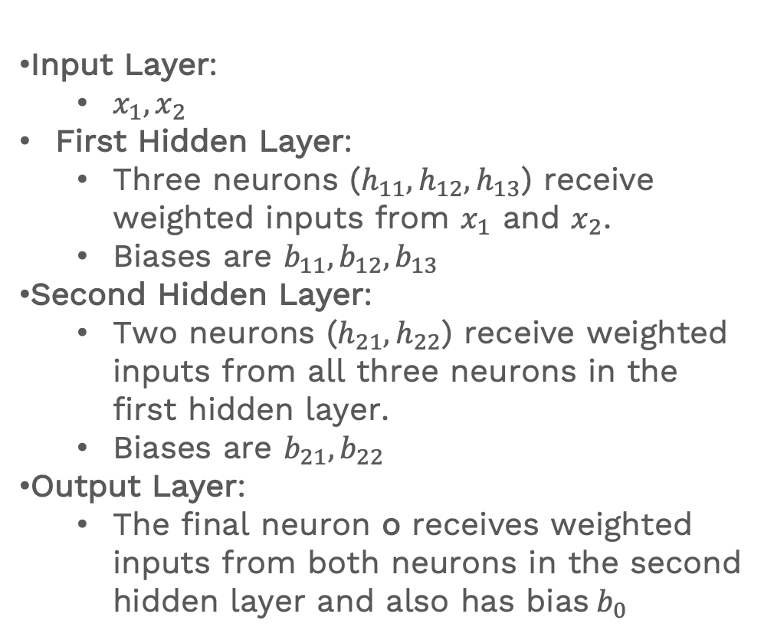
Forward Pass
Input Layer:
  $x_{1},x_{2}$
First Hidden Layer:
  Three neurons ($h_{11}, h_{12}, h_{13}$) receive weighted inputs from $x_{1}$​ and $x_{2}$​.
  Biases are $b_{11}, b_{12}, b_{13}$
Second Hidden Layer:
  Two neurons ($h_{21}, h_{22}$) receive weighted inputs from all three neurons in the first hidden layer.
  Biases are $b_{21}, b_{22}$
Output Layer:
  The final neuron o receives weighted inputs from both neurons in the second hidden layer and also has bias$b_{0}$

Slide 11
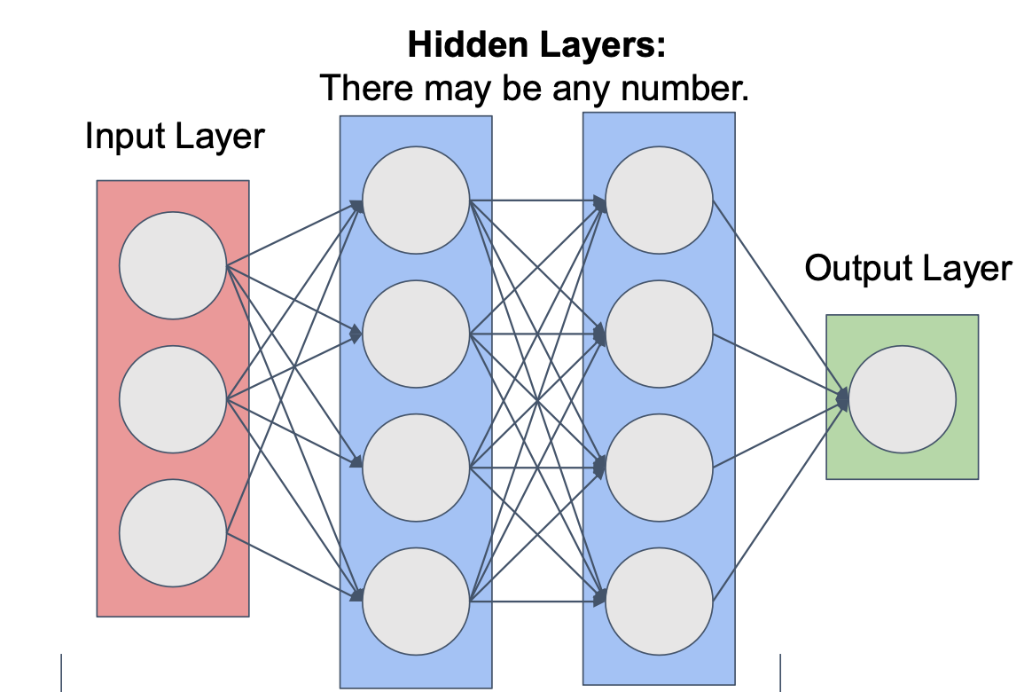
ANN - Architecture
Single Target Variable

Slide 12
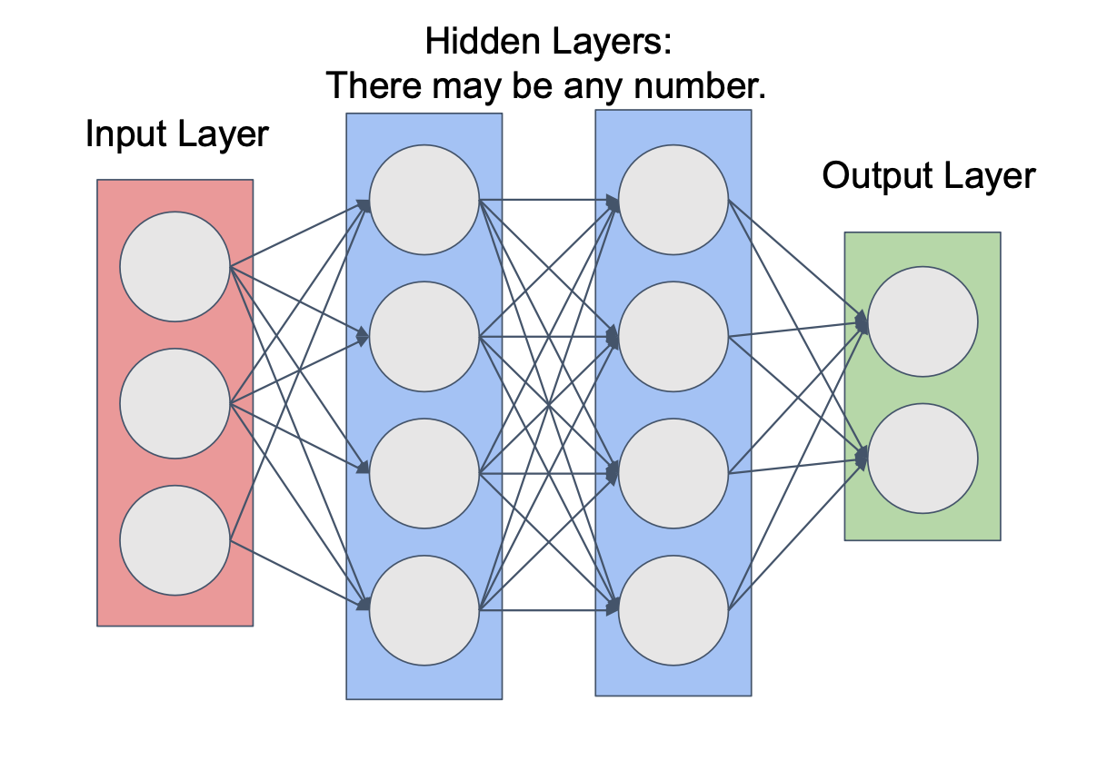
ANN - Architecture
Multiple Target Variables

Slide 13
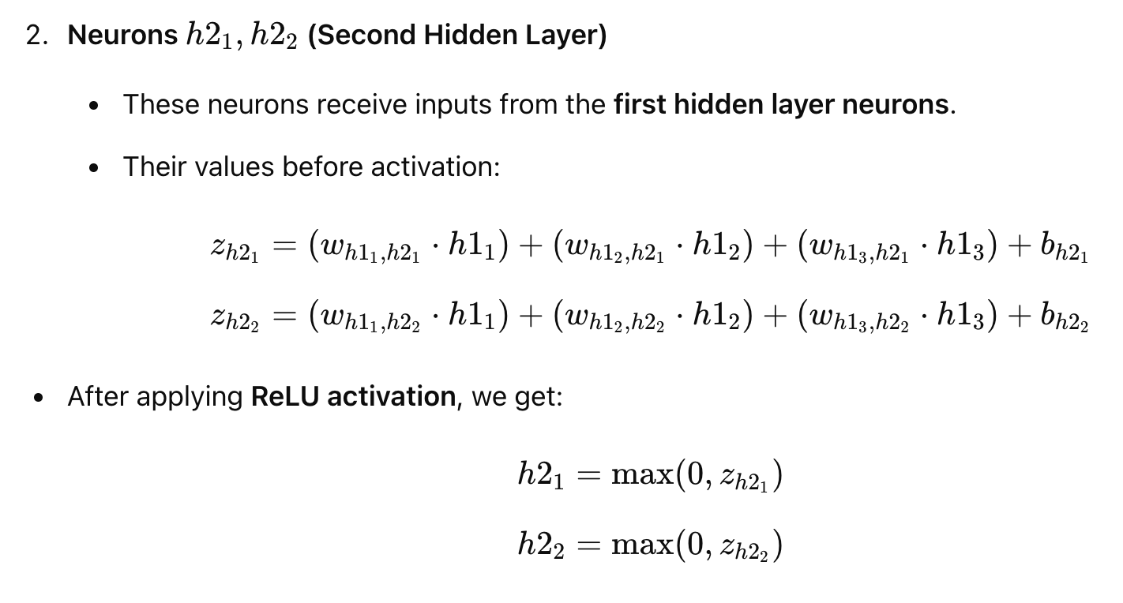
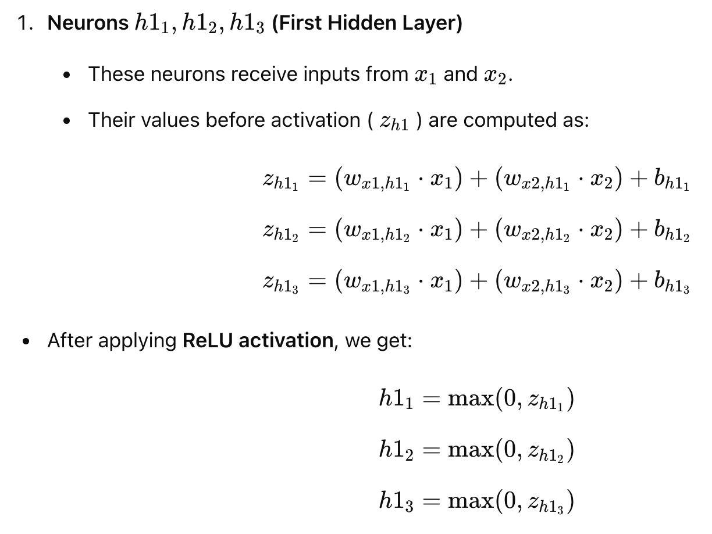

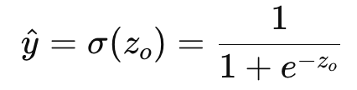
Forward Pass
3. Compute output layer
4. Apply Activation Function
Since we are solving a binary classification problem, we apply Sigmoid activation:

Slide 14
Activation functions
Introduces Non-Linearity
  Without an activation function, the network behaves like a linear transformation, limiting its ability to model complex relationships.
Enables Hierarchical Feature Learning
  Hidden layers apply transformations that help extract meaningful features from raw input data.
Prevents Network from Collapsing to a Single Linear Model
  A multi-layer perceptron (MLP) without activation functions is equivalent to a single-layer linear model.
Controls Information Flow
  Activations determine how much signal passes through neurons, filtering out unnecessary values (e.g., ReLU sets negative values to zero).

Slide 15
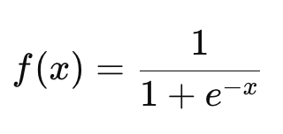
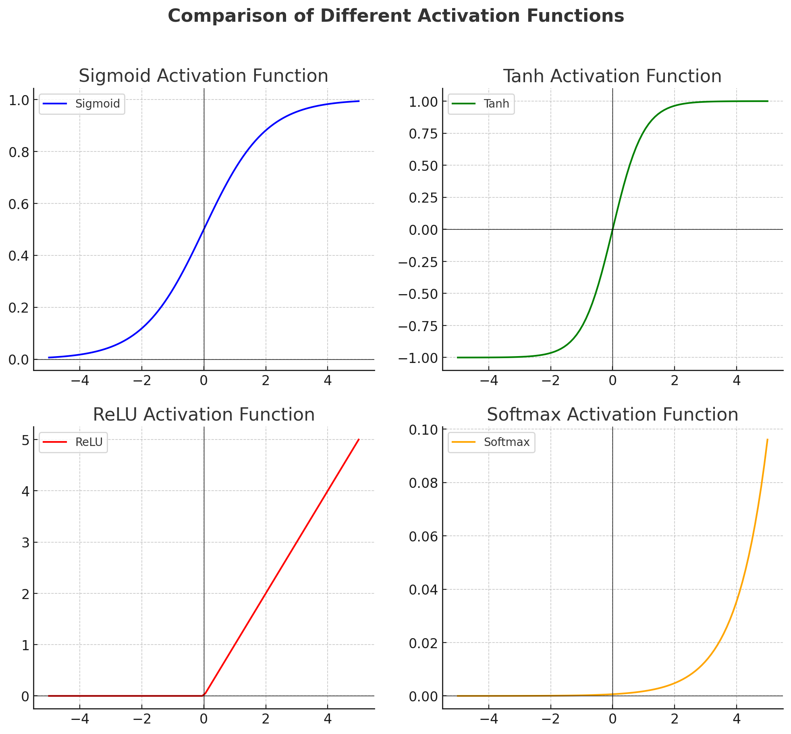
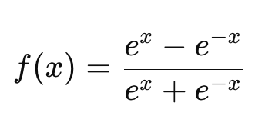

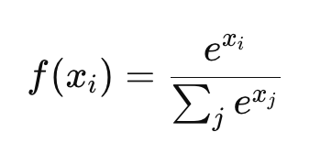
Different types of Activation Function
Sigmoid
Tanh (Hyperbolic Tangent)
ReLU (Rectified Linear Unit)
Softmax Activation Function

Slide 16
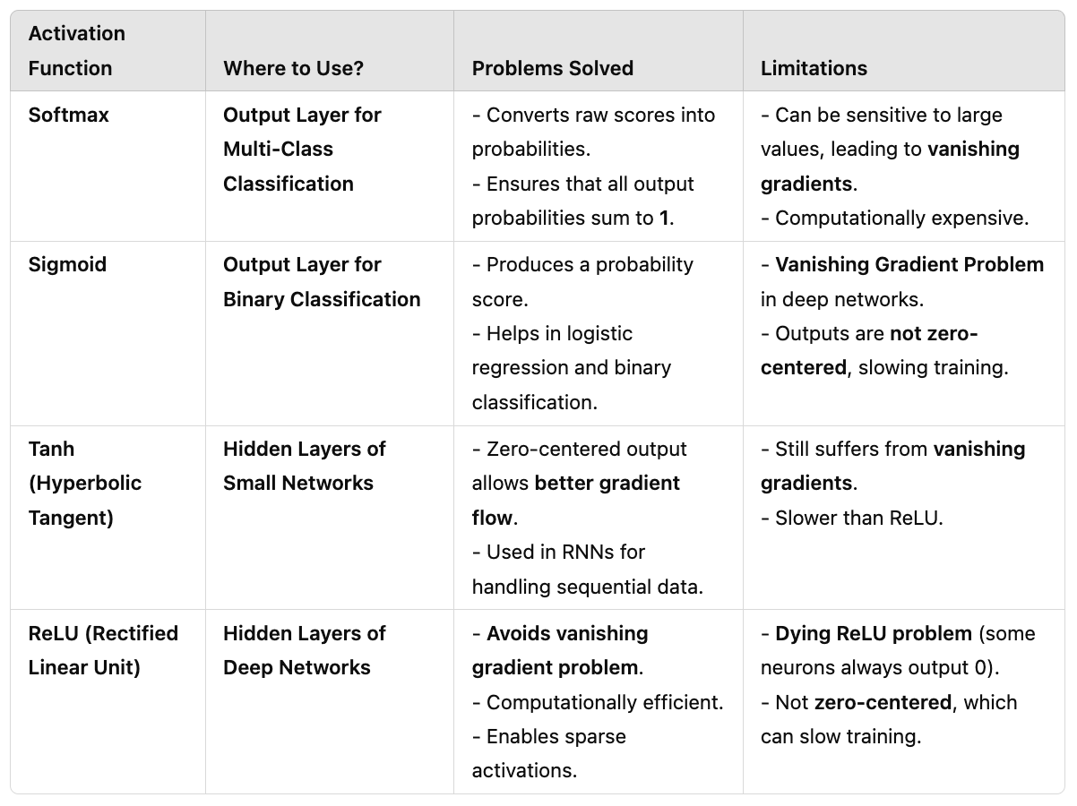
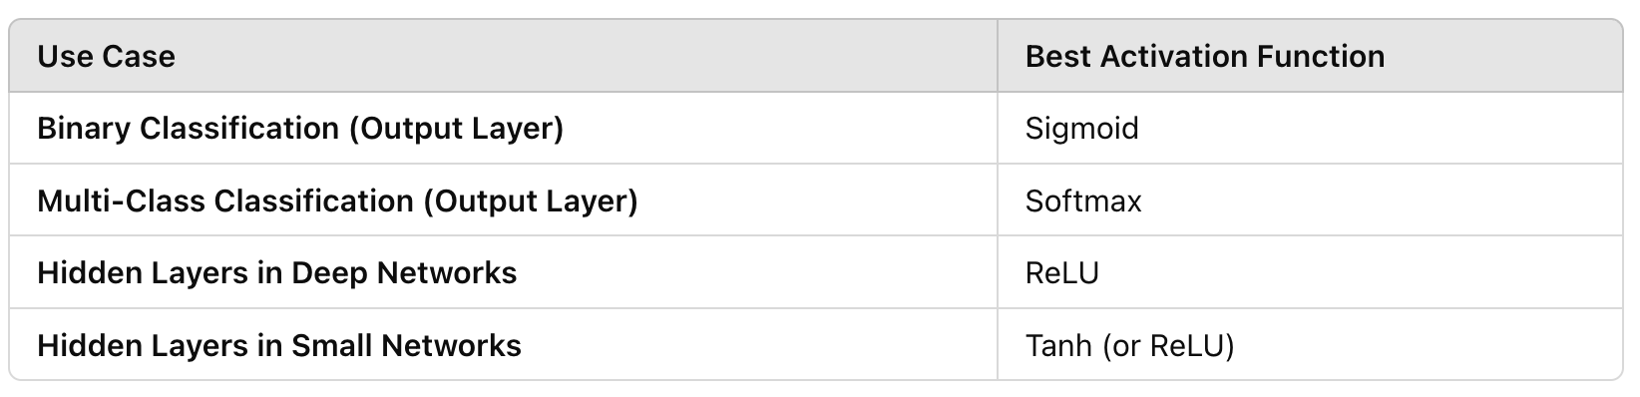
Comparison between Activations
What is Vanishing Gradient?
The gradients become extremely small as they are backpropagated through multiple layers.
This leads to very slow learning or even complete stagnation in training.

Slide 17
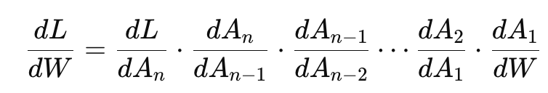
Vanishing Gradients
During backpropagation, gradients of the loss function are computed using the chain rule:
If the activation function’s derivative is very small (i.e., close to zero), the gradient values shrink exponentially as they propagate backward.
This results in earlier layers receiving almost no gradient updates, preventing them from learning.
How does it affect ANN ?
  Early layers learn very slowly or stop learning completely.
  Training becomes inefficient, requiring more epochs to converge.
  The network may not capture important features in deep architectures.

Slide 18
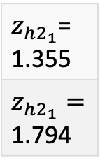






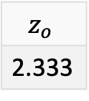
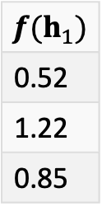

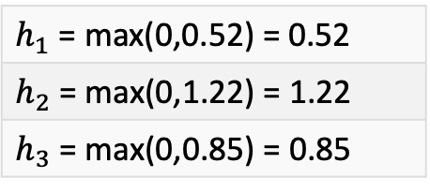


Example
Compute First Hidden Layer
X1 | X2
0.5 | 0.8
Weights for
layer 1
Bias
0.1
0.2
0.3
0.2 | 0.4
0.6 | 0.9
0.3 | 0.5
0.2 x 0.5 + 0.4 x 0.8
0.6 x 0.5 + 0.9 x 0.8
0.2 x 0.5 + 0.5 x 0.8
$$Z_{h1_{1}}$$
0.52
1.22
0.85
$h_{1}$ = max(0,0.52) = 0.52
$h_{2}$= max(0,1.22) = 1.22
$h_{3}$= max(0,0.85) = 0.85
ReLU
$$+$$
$$=$$
$$Z_{h1_{2}}$$
$$Z_{h1_{3}}$$
Compute Second Hidden Layer
Compute Output Layer
Weights for
layer 2
${f(h}_{1})$
0.52
1.22
0.85
Weights for
output layers
Bias
0.3
$$z_{o}$$
2.333
Bias
0.2
0.1
$z_{h2_{1}}$= 1.355
$z_{h2_{1}}=$ 1.794
1.355
1.794
$$+$$
$$=$$
0.7 | 0.3 | 0.5
0.4 | 0.8 | 0.6
$$+$$
$$=$$
0.5 | 0.7
Sigmoid
0.903

Slide 19
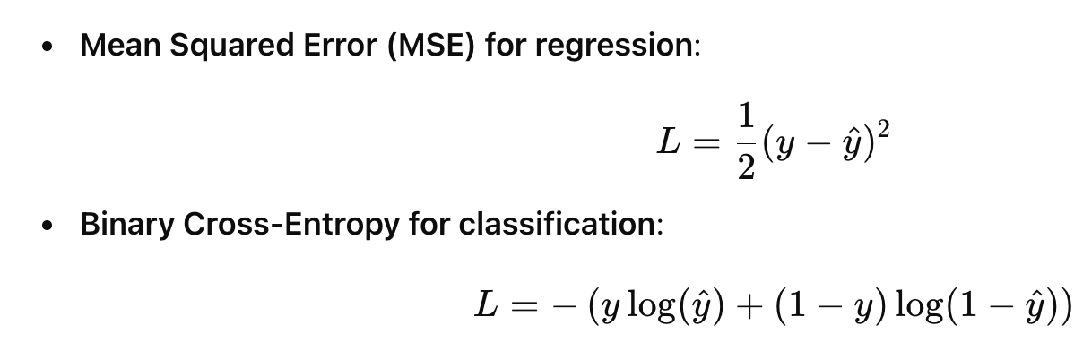
Error Calculation
From now on we will use Binary Cross-Entropy Loss in the following slides

Slide 20
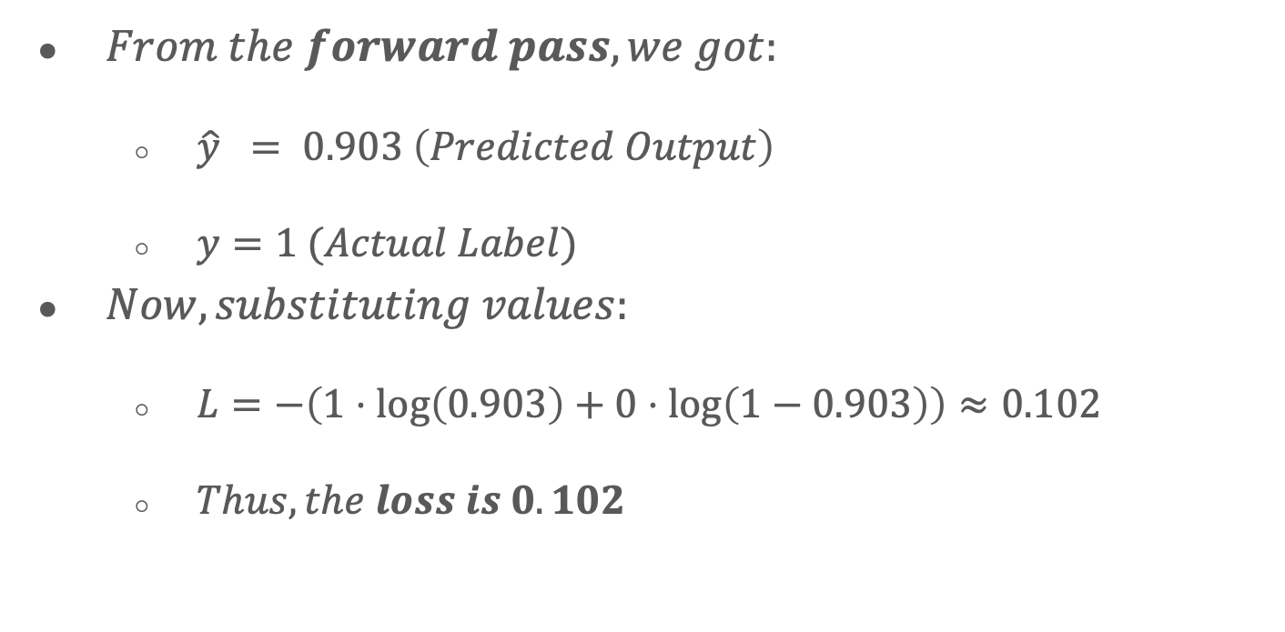
Example
$From the forward pass, we got:$
  $\hat{y} = 0.903 \left(Predicted Output\right)$
  $y=1 (Actual Label)$
$Now, substituting values:$
  $L=−\left(1⋅\log\left(0.903\right)+0⋅\log\left(1−0.903\right)\right)≈0.102$
  $Thus, the loss is 0.102$

Slide 21
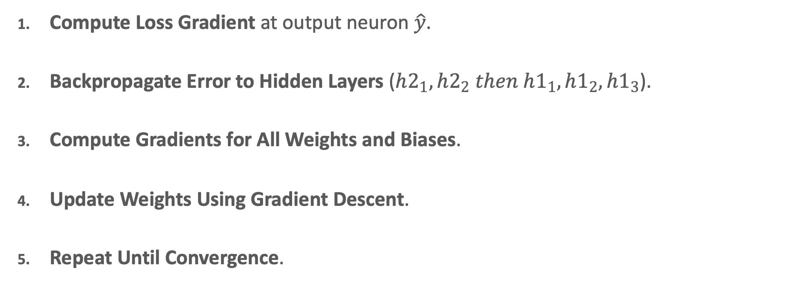
Backpropagations
Compute Loss Gradient at output neuron $\hat{y}$.
Backpropagate Error to Hidden Layers ($h2_{1}, h2_{2} then h1_{1}, h1_{2}, h1_{3}$​).
Compute Gradients for All Weights and Biases.
Update Weights Using Gradient Descent.
Repeat Until Convergence.

Slide 22
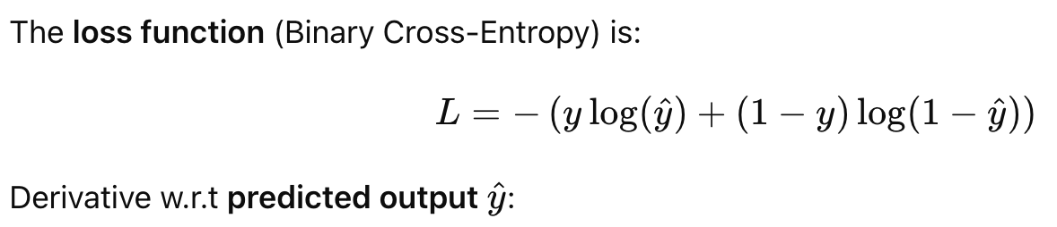
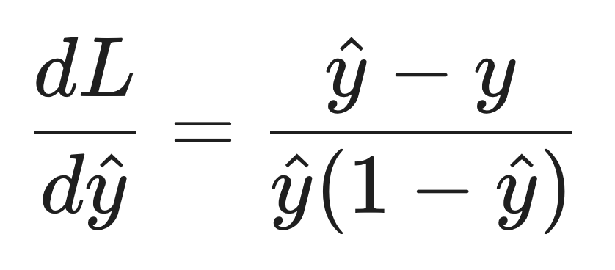
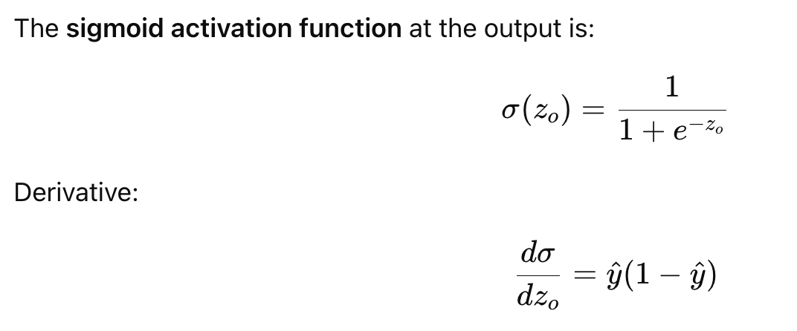
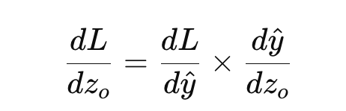
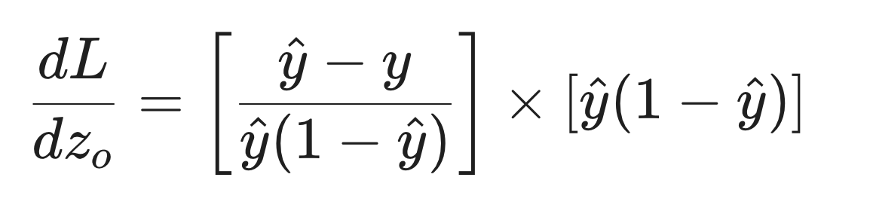
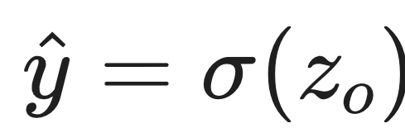
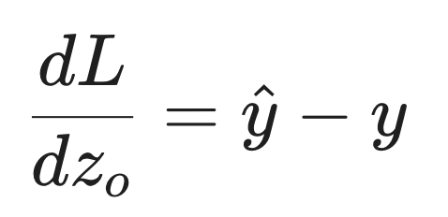
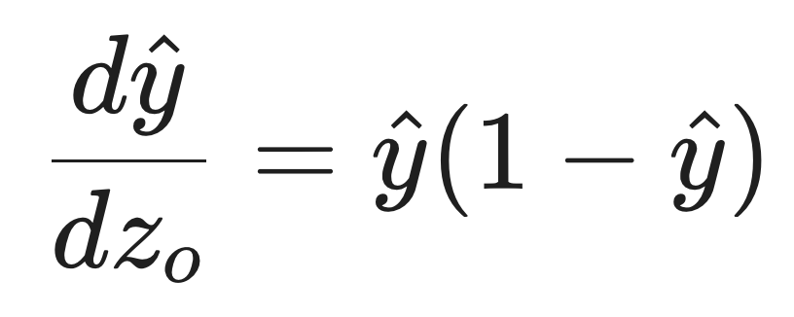
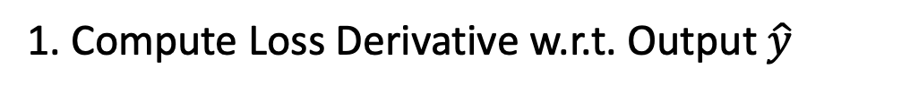
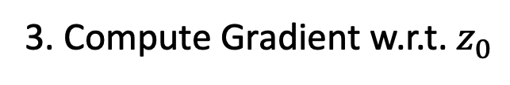
Compute gradient of the output layer
1. Compute Loss Derivative w.r.t. Output $\hat{y}$
3. Compute Gradient w.r.t. $z_{0}$
2. Compute Derivative of Sigmoid Activation

Slide 23
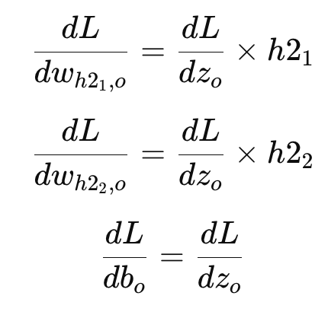
Compute Gradients for Weights and Bias (Output Layer)

Slide 24
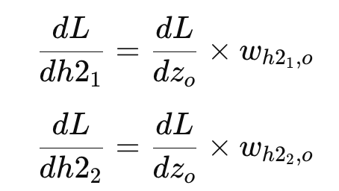
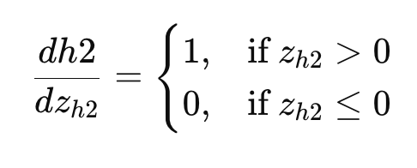
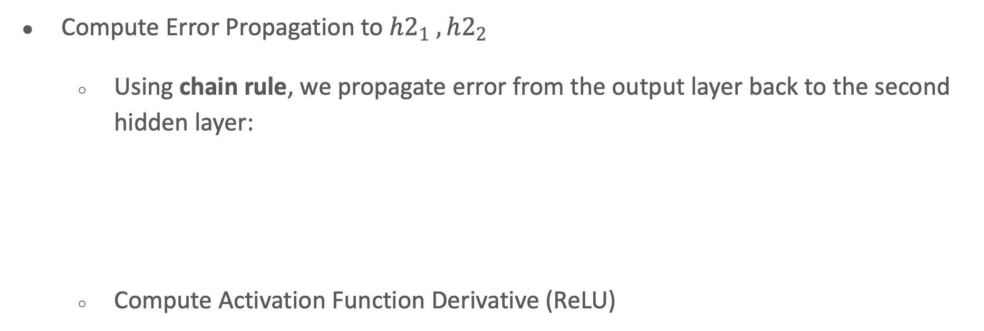
Compute gradient for second hidden layer $h2_{1} , h2_{2}$
Compute Error Propagation to $h2_{1} , h2_{2}$
  Using chain rule, we propagate error from the output layer back to the second hidden layer:
  Compute Activation Function Derivative (ReLU)

Slide 25
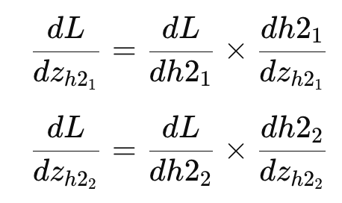
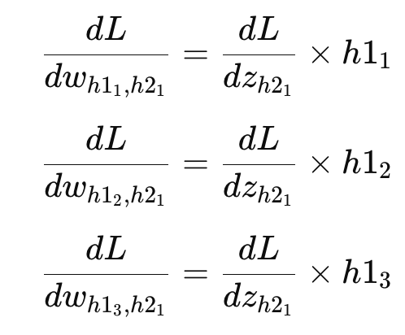
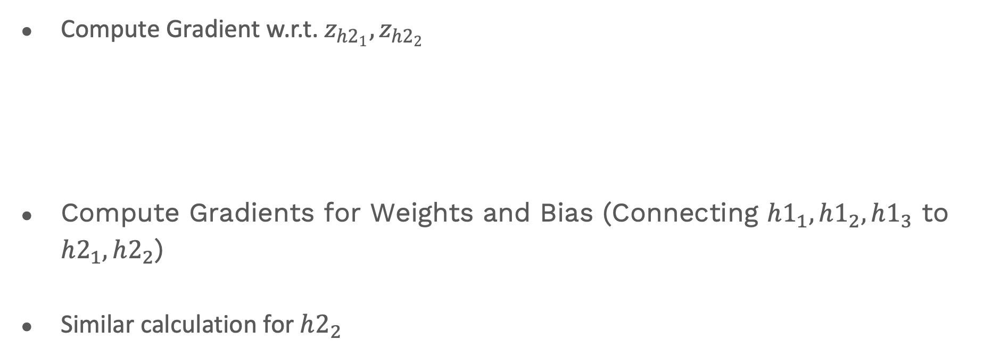
Compute gradient for second hidden layer $h2_{1} , h2_{2}$
Compute Gradient w.r.t. $z_{h2_{1}},z_{h2_{2}}$
Compute Gradients for Weights and Bias (Connecting $h1_{1}, h1_{2}, h1_{3}$ to $h2_{1}, h2_{2}​$)
Similar calculation for $h2_{2}$

Slide 26
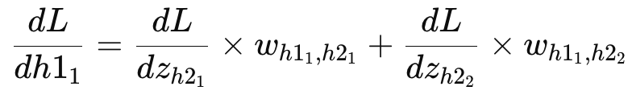
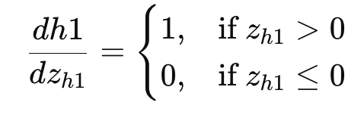
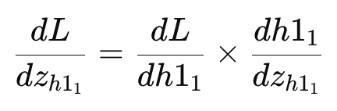
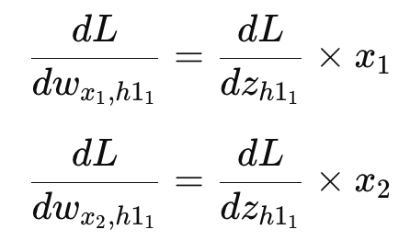
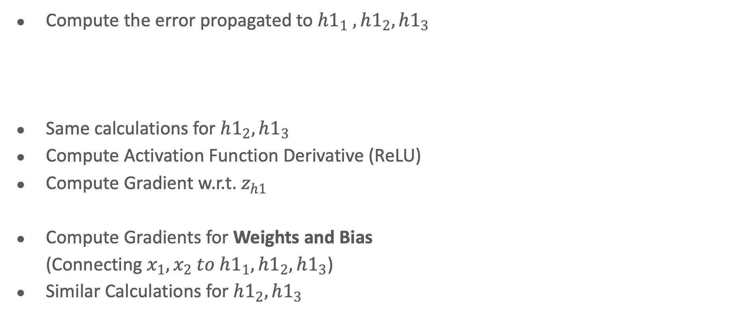
Compute gradient for First hidden layer $h1_{1} , h1_{2}, h1_{3}$
Compute the error propagated to $h1_{1} , h1_{2}, h1_{3}$
Same calculations for $h1_{2}, h1_{3}$
Compute Activation Function Derivative (ReLU)
Compute Gradient w.r.t. $z_{h1}$​
Compute Gradients for Weights and Bias
(Connecting $x_{1}, x_{2}​ to h1_{1}, h1_{2}, h1_{3}​$)
Similar Calculations for $h1_{2}, h1_{3}$

Slide 27

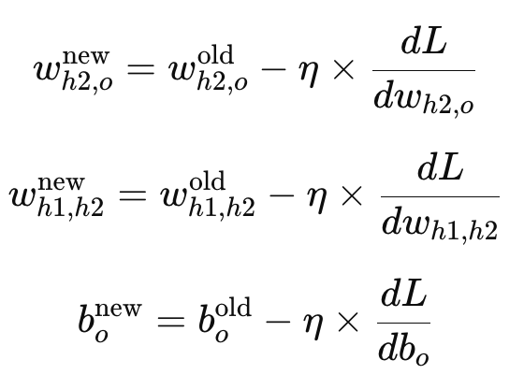
Update Weights Using Gradient Descent
Once gradients are computed, update weights using the gradient descent update rule:
For example:

Slide 28
Repeat Until Convergence
Repeat forward pass + backpropagation for multiple epochs.
Training stops when
  Loss function stabilizes (convergence).
  Gradient updates become very small.
  Early stopping is triggered to avoid overfitting.

Slide 29
Summarization of Backpropagation algorithm
Initialize weights, biases, and learning rate.
Perform forward pass to compute activations and loss.
Compute gradients for output layer.
Backpropagate errors through hidden layers.
Update weights and biases using gradient descent.
Repeat until the model converges.

Slide 30
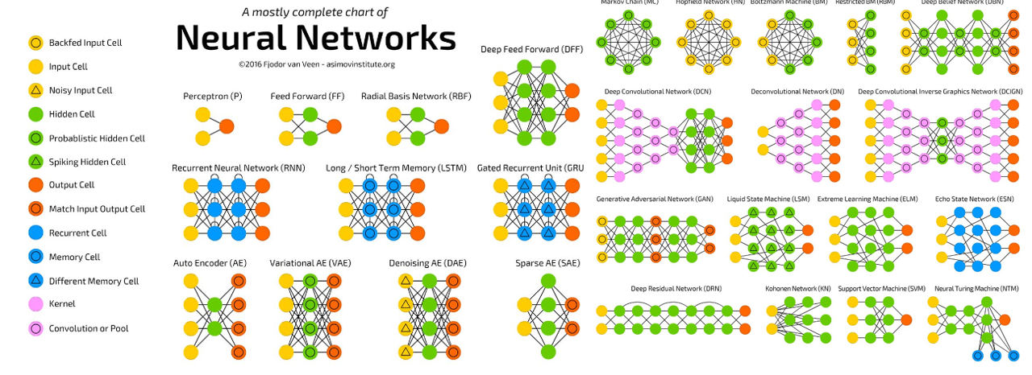
Complex ANN models

Slide 31
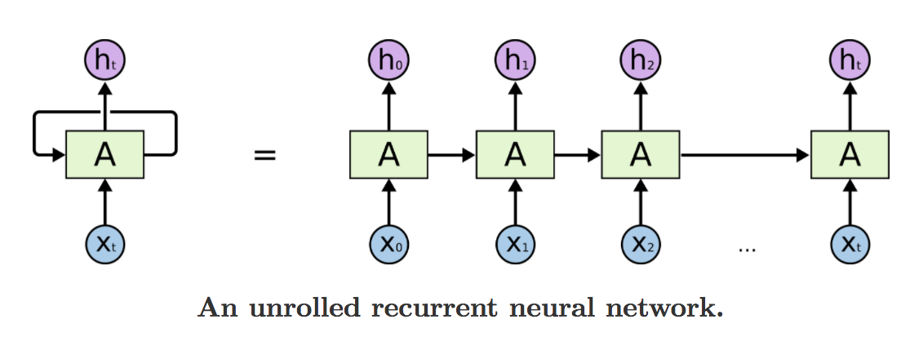


RNN
The output from the previous step is fed back into the network as an input for the current step.
This creates a looping mechanism that allows information to persist.
$h_{t}$ is the current hidden state.
$φ$ is an activation function (e.g., tanh)
$W_{h}$and $W_{x}$ are weight matrices.
$x_{t}$ is the input at the current time step.
Limitations to Consider
  Vanishing Gradient Problem: Forget information from the beginning of long sequences.
  Solution: LSTM (Long Short-Term Memory) and GRU (Gated Recurrent Unit)

Slide 32







LSTM
Architecture designed to address the vanishing gradient problem
Capture long-term dependencies in sequential data.
Cell State ($C_{t}$)
Hidden State ($h_{t}$)
Input gate ($i_{t}$)
Forget gate ($f_{t}$)
Output gate ($o_{t}$)
Notes:
Cell State (Cᵗ): This represents the memory of the LSTM and can store information over long sequences. It can be updated, cleared, or read from at each time step.
Hidden State (Hᵗ): The hidden state serves as an intermediary between the cell state and the external world. It can selectively remember or forget information from the cell state and produce the output.
Input Gate (iᵗ): The input gate controls the flow of information into the cell state. It can learn to accept or reject incoming data.
Forget Gate (fᵗ): The forget gate determines what information from the previous cell state should be retained and what should be discarded. It allows the LSTM to “forget” irrelevant information.
Output Gate (oᵗ): The output gate controls the information that is used to produce the output at each time step. It decides what part of the cell state should be revealed to the external world.
1. Why Sigmoid for the Gates?
The Sigmoid function ($\sigma$) outputs values strictly between 0 and 1.
In the context of a "gate," this acts as a valve:
0: The gate is "closed"—no information passes through.
1: The gate is "open"—all information passes through.
0.5: Half of the information passes through.
Because the gates (Forget, Input, Output) are meant to filter or mask data, we need a function that can mathematically represent "how much" of something to keep. A function that goes negative (like Tanh) wouldn't make sense for a "percentage-based" filter.
2. Why Tanh for the Cell and Hidden States?
The Tanh function outputs values between -1 and 1.
LSTMs use Tanh for the Candidate Memory ($\tilde{C}_t$) and the Hidden State ($h_t$) for two main reasons:
A. Overcoming the "Exploding Gradient"
As information flows through many time steps, the values in the cell state could grow infinitely large if we didn't regulate them. Tanh normalizes the data, squashing it back into a predictable range (-1 to 1). This keeps the math stable during long-sequence training.
B. Allowing for Decreases (Negative Values)
Unlike Sigmoid, Tanh can be negative. This is crucial for the cell state:
If we want to subtract or "counteract" a certain feature from the memory, we need negative values.
If we only used Sigmoid (0 to 1), we could only ever add to the memory, which would eventually saturate the network.

Slide 33
LSTM
Where is it useful ?
  analyzing time-series data from sensors (voltage, current, temperature, etc.)
    such as estimating state-of-charge (SOC),
    forecasting degradation,
    predicting remaining useful life (RUL)
Often rely on the temporal nature.

Slide 34

Convolutional Neural Network
Designed to process grid-like data, such as images.
Three Layers
  Convolution
  Pooling (Subsampling)
  Fully Connected
Hyperparameters
  Stride
  Padding
  Channels
Notes:
The Three Key Layers
1. Convolutional Layer: It applies multiple filters to the input to extract features like edges, textures, and eventually complex shapes.
2. Pooling Layer (Subsampling): Reduces the spatial size (Width x Height) of the data.
Max Pooling: Keeps only the strongest signal in a region (e.g., $2 \times 2$ grid).
Benefit: Reduces computation and helps prevent overfitting.
3. Fully Connected (FC) Layer: After extracting features, the data is "flattened" and fed into a standard network to make the final classification (e.g., "Cat" vs "Dog").
Critical Hyperparameters
1. Stride: The number of pixels the filter moves at each step. Stride 1 = detailed; Stride 2 = faster/smaller output.
2. Padding: Adding "fake" zero-pixels around the border so the filter can scan edges without shrinking the image size.
3. Channels: Images usually have 3 channels (RGB). Filters are 3D volumes that scan all colors simultaneously.

Slide 35
Convolutional Neural Netowork
Where is it Useful ?
  If your battery prediction task involves sensor arrays or spatial data (for example, thermal imaging or electrode microstructure images), CNNs can efficiently extract local features from these multi-dimensional data.
Hybrid of LSTM and CNN enhance strength
  CNN layers to extract spatial features
  Then use LSTM layers to process the temporal sequence of these features.

Slide 36
Hands-on

Slide 37


Thank You!
sourasb05@gmail.com
sourasekhar.banerjee@it.uu.se
sourasb05.github.io
Social media

